Slide 1
Health Insurance Cross Sell Prediction
Artemis 7 - Final Project Rakamin Batch 14

Slide 2

ARTEMIS 7
A company that engaged in the insurance sector. Currently, we already have health insurance products and will expand to vehicle insurance.
In this company, we have a Data Science team who asked to build a model to predict whether policyholders (customers) from last year will also be interested in the Vehicle Insurance provided by the company.

Slide 3





Who is the Team ?
Sonya Adella
Team Lead /
Sr. Data Scientist
Ramdani Hidayat
Data Scientist
Andi Ainun Najib
Data Scientist
Hira Nasmy
Business Analyst
Hafizh Fakhri Alfarisy
Business Analyst

Slide 4
01
Project Background

Slide 5
The Remarkable Widespread of Vehicle
The Insurance of Motor-based vehicle initially skyrocketed after the 2nd Industrial Revolution
The widespread use of motor-based vehicle began after the First World War and the 2nd industrial revolution in urban areas. Cars were relatively fast and dangerous by that stage, yet there was still no compulsory form of car insurance anywhere in the world. This meant that injured victims would rarely get any compensation in an accident and drivers often faced considerable costs for damage to their car and property.
Source : Vehicle insurance - Wikipedia

Slide 6

The Remarkable Widespread of Vehicle
The insurance regulation in Indonesia still extremely limited
In Indonesia, auto insurance is legally called Dana Pertanggungan Wajib Kecelakaan Lalu Lintas Jalan(DPWKLLJ) was introduced in 1964 and merely covers body injuries, and is operated by a SOE called PT Jasa Raharja (Persero).
DPWKLLJ only cover life/body injuries, then how about if only vehicle damage or lost? There is no insurance yet.
So, to help anticipate excess expenses due to vehicle damage, either because of accidents or loss, we need vehicle insurance.
Source : Vehicle insurance - Wikipedia

Slide 7
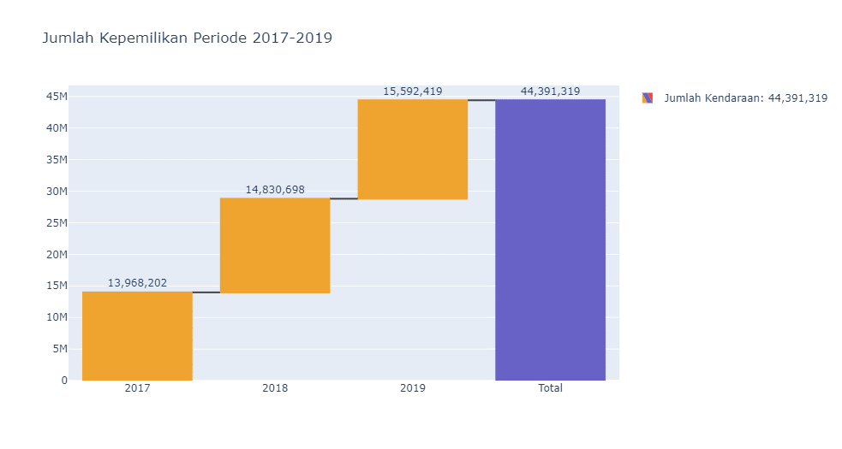
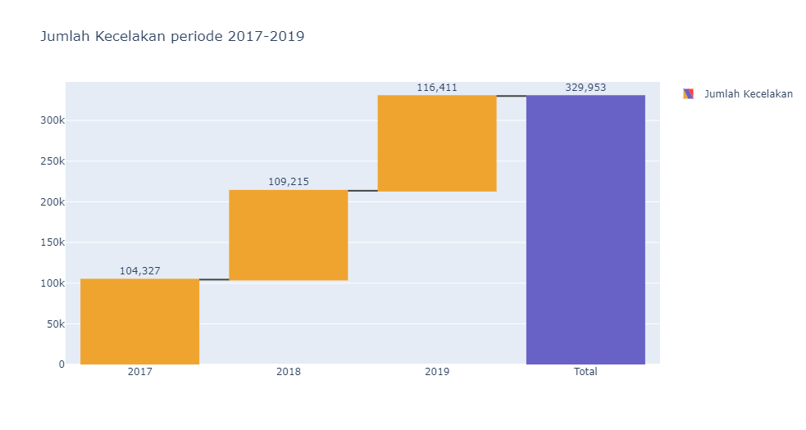
Vehicle Insurance in Indonesia
The number of vehicle grows linearly with its incident numbers
Vehicle ownership
Vehicle accidents
ANNUALLY INCREASED
Source :
https://www.bps.go.id/indicator/17/513/1/jumlah-kecelakaan-korban-mati-luka-berat-luka-ringan-dan-kerugian-materi.html
https://www.bps.go.id/indicator/17/57/1/jumlah-kendaraan-bermotor.html

Slide 8
02. Goals
04. Business Metrics
Build a model to predict customer interest in vehicle insurance.
Focused to
Purchase Rate
01. Problem
03. Objective
Plan a communication strategy to reach those customers and optimize the business model.
Notes:
Dlihat dari data sebelumnya perusahaan melihat potensi untuk membuat asuransi kendaraan sehingga, perusahaan artemis meminta kami tim data scientist untuk melakukan analisis data dengan membuat model untuk memprediksi ketertarikan customer terhadap asuransi kendaraan.

Slide 9
02
Data PreProcessing

Slide 10



Dataset Information
381.109
11
1
rows
features
target
Id
Gender
Age
Region _Code
Driving_License
Previously_Insured
Vehicle_Age
Vehicle_Damage
Annual_Premium
Policy_Sales_Chanel
Vintage
Response

Slide 11
Dataset Information
Column | Description | Data Type | Missing Value | Remarks
id | Unique ID for the customer | Numerical | 0 | Min : 1 Max : 381,109 | Mean : 190,555 Median : 190,555
Gender | Gender of the customer | Catagorical | 0 | 2 unique values ;Male and Female
Age | Age of the customer | Numerical | 0 | Min : 20 Max : 85 | Mean : 38 Median : 36
Driving_License | 0 : Customer does not have DL 1 : Customer already has DL | Catagorical | 0 | 2 unique values Yes and No
Region_Code | Unique code for the region of the customer | Numerical | 0 | Min : 0 Max : 52 | Mean : 26 Median : 28
Previously_Insured | 1 : Customer already has Vehicle Insurance 0 : Customer doesn't have Vehicle Insurance | Catagorical | 0 | 2 unique values
Vehicle_Age | Age of the Vehicle | Catagorical | 0 | 3 unique values; 1-2 Year < 1 Year >2 Year
Vehicle_Damage | 1 : Customer got his/her vehicle damaged in the past. 0 : Customer didn't get his/her vehicle damaged in the past. | Catagorical | 0 | 2 unique values
Annual_Premium | The amount customer needs to pay as premium in the year | Numerical | 0 | Min : 2,630 Max : 540,165 | Mean : 30,564 Median : 28
PolicySalesChannel | Anonymized Code for the channel of outreaching to the customer ie. | Numerical | 0 | Min : 1 Max : 163 | Mean : 112 Median : 113
Vintage | Number of Days, Customer has been associated with the company | Numerical | 0 | Min : 10 Max : 299 | Mean : 154 Median : 154
Response | 1 : Customer is interested 0 : Customer is not interested | Catagorical & Target | 0 | 2 unique values
Target

Slide 12
Missing Values & Duplicate data
Fortunately, the data is totally clean
0
0
Missing Values
Duplicate Data

Slide 13



Data Cleansing & Preprocessing
Applying Responsible AI to avoid ML Bias
Gender
Id
Region Code

Slide 14
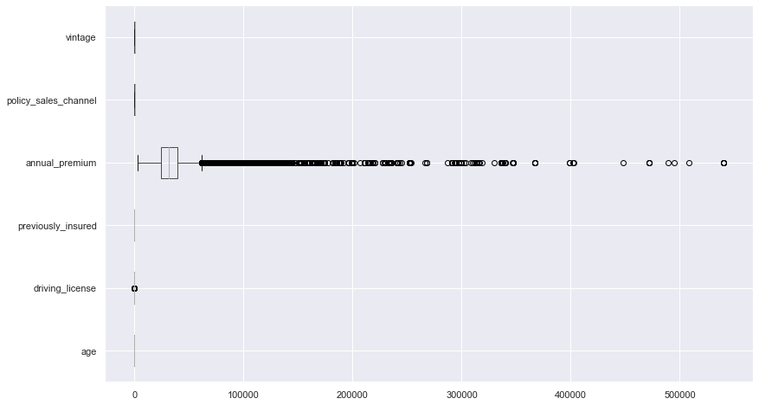
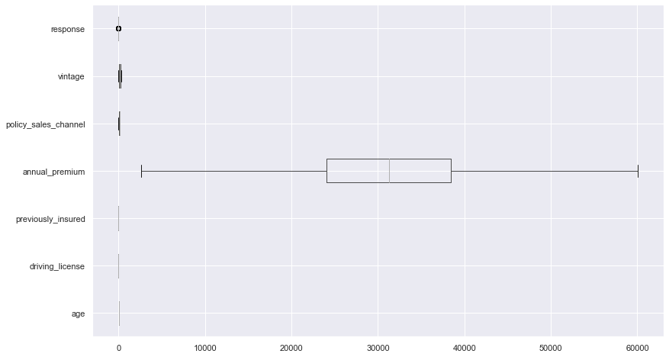
Data Cleansing & Preprocessing
IQR method helps handling outlier case optimally
381,109
370,789
Before
After
3%
Decreasing

Slide 15
Feature Engineering
Using One Hot Encoding for selected column
Features | After
Vehicle_Damage | Vehicle_Damage_No | Vehicle_Damage_Yes
Vehicle_Age | Vehicle_Age_1-2 Year | Vehicle_Age_<1 Year | Vehicle_Age_>2 Year

Slide 16
03
Exploratory Data Analysis

Slide 17
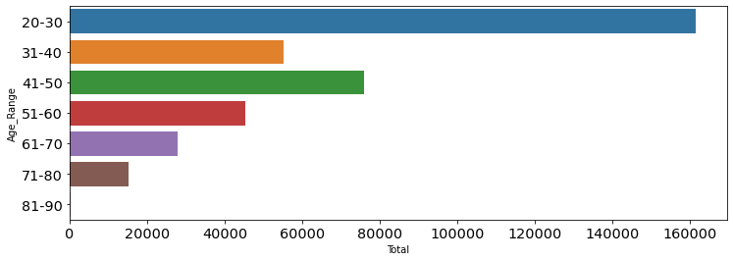

EDA Insight
Young adult category outnumbered all other age groups
161,461
For Group 20-30

Slide 18
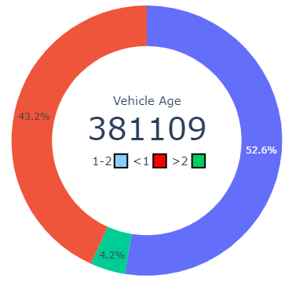

EDA Insight
Vehicle age that more than 2 years is the rarest fact
1st
2nd
3rd
For 1-2 years
Below
1 years
More than
2 years

Slide 19
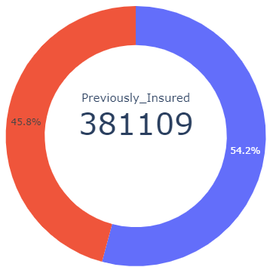
EDA Insight
Most of the people in the dataset are not previously insured
Yes
No
174,628
206,481

Slide 20
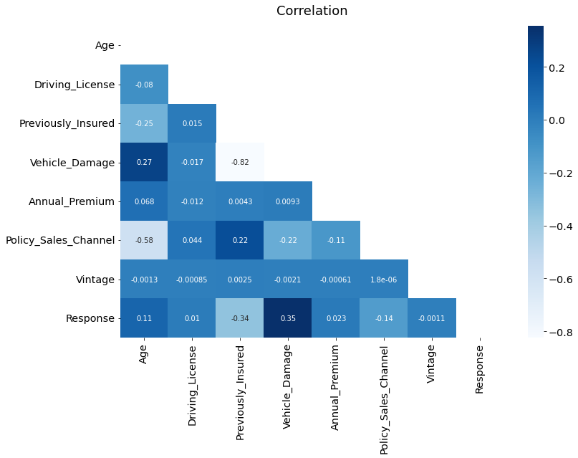
EDA Insight
All features are correlated weakly to each other
Highest correlation for
Response and Vehicle Damage
at 0.35.
Target

Slide 21
04
Modeling

Slide 22
ML Comparison - Classifier
Random Forest outperformed all other ML models by AUC and F1-Score.
Model | Accuracy | AUC | Recall | Precision | F1- Score | Training Time (sec)
Random Forest | 0.8670 | 0.9491 | 0.8997 | 0.8445 | 0.8712 | 19.8970
Decision Tree | 0.8588 | 0.8615 | 0.8720 | 0.8495 | 0.8606 | 0.6240
Naïve Bayes | 0.8028 | 0.8343 | 0.9468 | 0.7350 | 0.8276 | 0.1330
Logistic Regression | 0.7839 | 0.8547 | 0.9469 | 0.7145 | 0.8142 | 1.4770
Legend :
Accuracy is percentage of prediction were correct.
AUC (Area Under the Curve) means model has a good measure of separability if it has AUC near to 1.
Recall is actual positive rate.
Precision is predicted positive rate
F1-Score combines Recall and Precision to one performance matrix.
Notes:
Accuracy = TP + TN /Total
Precision = TP/TP+FP
Recall = TP/FN+TP
F1-score = 2*precision*recall/precision+recall 🡪 extreme imbalance class
AUC Curve : 🡪 not extreme imbalance
TPR = TP/TP+FN
FPR = FP/FP+TN
“modeling dan evaluation, model clasifikasi yaitu ….., metrik evaluasi yang dibandingkan adalh ….. hasil perbanding model algoritma Random forest memiliki nilai evaluasi yang lebih optimal . dan kelompok kami lebih memerhatikan nilai accurasy dan AUC untuk mengurangi kesalahan prediksi membeli/tidak membeli / dari nilai AUC yang mendekati 1 sehingga tidak banyak hasil yang tidak pasti (ketidak pastian)
Accuracy menggambarkan seberapa akurat model dapat mengklasifikasikan dengan benar. Maka, accuracy merupakan rasio prediksi benar (positif dan negatif) dengan keseluruhan data.ccuracy merupakan tingkat kedekatan nilai prediksi dengan nilai aktual (sebenarnya). Nilai accuracy dapat diperoleh dengan persamaan (1).
Semakin tinggi AUC, semakin baik kinerja model dalam membedakan kelas positif (Orang yg tertarik) dan negatif (orang yang tidak tertarik).

Slide 23
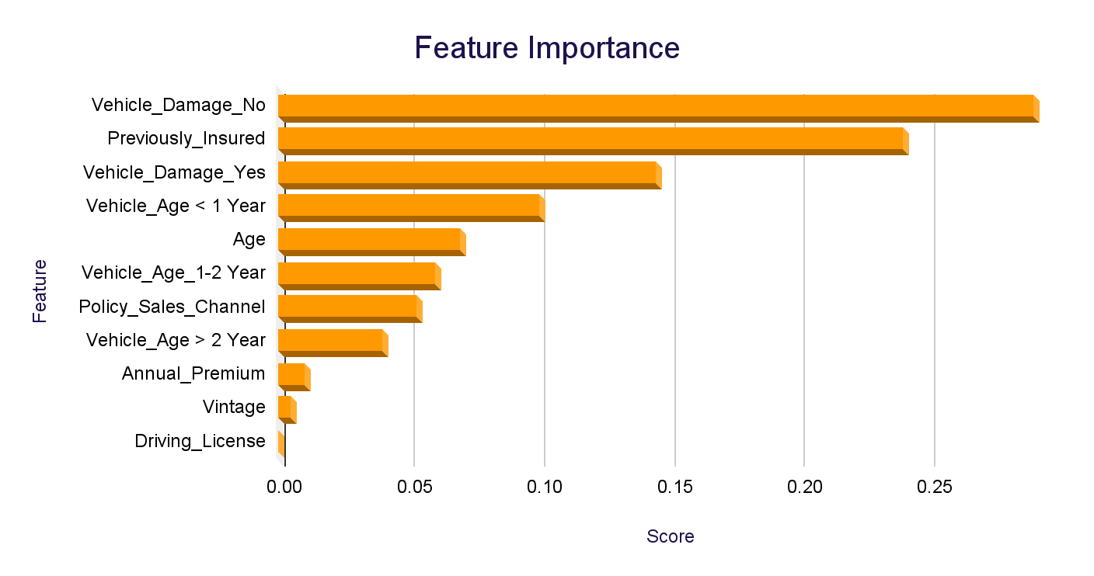
Feature Importance
Vehicle Damage and Previously Insured are the top two strongest factors
2X
2,5X
7X
Vehicle_Damage_No given impact than Vehicle_Damage_Yes
Previously_Insured given impact than Vehicle_Age < 1 Years
Age given impact than Annual_Premium
Notes:
Pada data feature importance bisa kita lihat bahwa Vehicle damage, previoused insured, age anual premium,
yg paling berpengaruh adalah vehicle damage no yang menggabarkan pembeli ansuran lebih awar jika kendaraan tersebut belum mengalami kerusakan, dari pada yg telah mengalami kerusakan. dan juga beradarkan pengalaman (telah mengambil ansuransi sebelumnya) memberikan impact yg lebih dari pada umur kendaraan,

Slide 24
05
Business Insight and Recommendation

Slide 25
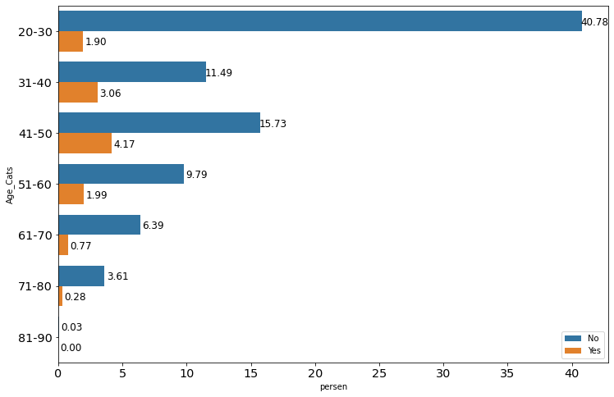
Customer Profile and Response
The Adult customer converted mostly than the teenagers/young adult
Insight :
Highest interest in product among age 41-50 years at 4.17%.
Business Recommendation :
Main focused in age range 41-50 for product.

Slide 26
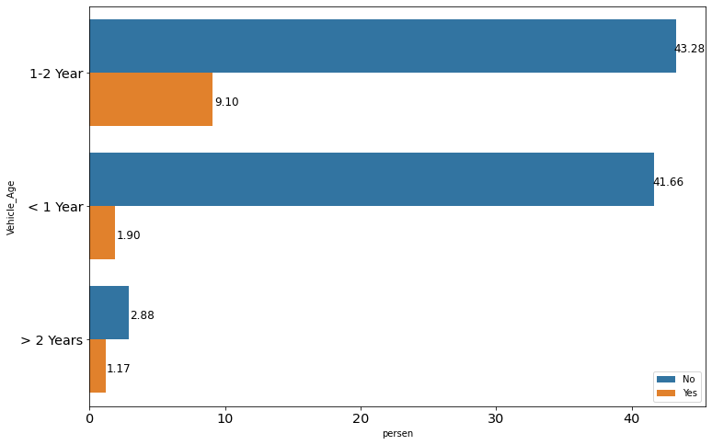
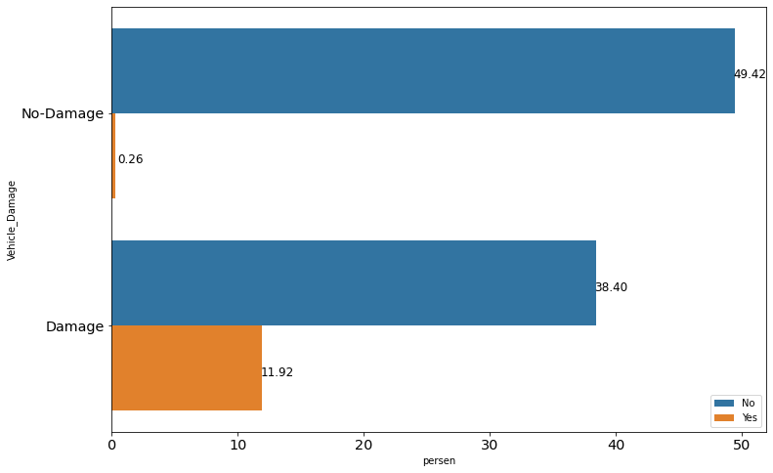
Vehicle Profile and Response
Damaged vehicle and 1-2 vehicle age dominated the conversion rate
Insight :
Highest positive response customers with a Vehicle Age of 1-2 years at 9.10% and Damage Vehicle at 11.92%
Business Recommendation :
Gain more customers in Vehicle Age 1-2 years
Gain more customers in Vehicle Damage = Yes

Slide 27
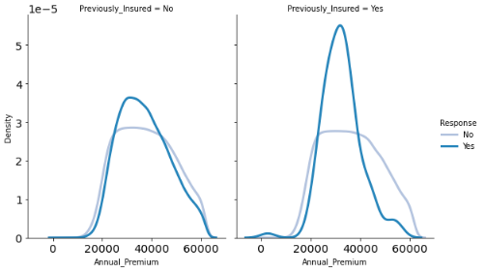
Product Rate and Response
The middle price (20k - 40k) has the highest potential response
Insight :
High percentage positive response for Annual Premium in range 20,000-40,000.
Business Recommendation :
Focused product rate for Vehicle Insurance in range 20,000 – 40,000.

Slide 28
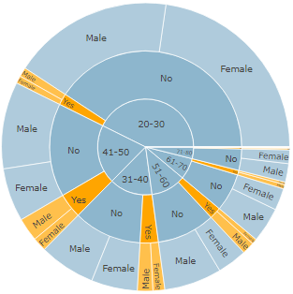
Customer Type
Insight :
Rendahnya ketertarikan pada produk di kalangan usia muda (20-30)
Ketertarikan pada kalangan 41-50 pada produk lebih baik
Solution Recommendation :
Meningkatkan ketertarikan terhadap asuransi kendaraan bagi kalangan usia muda (20-30 tahun).
Marketing Plan & Strategy :
Memanfaatkan social media sebagai sarana dalam mempromosikan produk dan juga mengedukasi orang-orang akan pentingnya mengasuransikan kendaraannya.

Slide 29
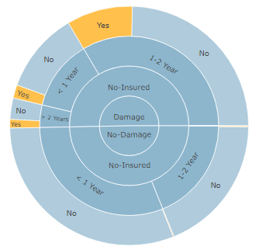
Vehicle Type
Insight :
Rendahnya ketertarikan akan produk meskipun kendaraan pernah mengalami kecelakan dan umur kendaraan yang masih relative baru (< 1 tahun dan 1-2 tahun).
Solution Recommendation :
Meningkatkan ketertarikan terhadap asuransi kendaraan khususnya pada layanan fasilitas bengkel.
Mempermudah proses klaim asuransi di bengkel rekanan.
Marketing Plan & Strategy :
Bekerja sama dengan berbagai dealer, showroom, platform jual beli kendaraan online, leasing, dan bengkel guna meningkatkan pasar penjualan.

Slide 30
Product Type
Insight :
Range harga Annual Premium yang memiliki ketertarikan berada pada range 20,000-40,000
Marketing Plan & Strategy :
Menyediakan berbagai macam jenis produk asuransi kendaraan.
Bundling produk asuransi kesehatan dan asuransi kendaraan.
Menyediakan layanan konsultasi agar memudahkan calon pelanggan memilih produk asuransi.

Slide 31
Thank You

Slide 32
Appendix
https://www.kaggle.com/anmolkumar/health-insurance-cross-sell-prediction?select=train.csvVehicle insurance – Wikipedia
https://www.bps.go.id/indicator/17/513/1/jumlah-kecelakaan-korban-mati-luka-berat-luka-ringan-dan-kerugian-materi.html
https://www.bps.go.id/indicator/17/57/1/jumlah-kendaraan-bermotor.html

